Slide 1
E-Module
On
Emergence of Special Theory of Relativity
Dr. Soubhik Chattopadhyay
Department of Physics
Sovarani Memorial College

Slide 2
Course outcomes
After completing the course the students will be able
To learn about the inconsistencies of classical relativity given by Galileo and Newton.
To learn about Galilean transformations.
To learn about the incapability of Galilean transformation in case of transformations of the laws of electromagnetism.
To learn about the Michelson-Morley Experiment.
To learn about the non-exsistance of ether medium.
Develop Conceptions of need of Special Theory of Relativity
To solve quantitative problems involving Galilean transformations.

Slide 3
Relativity
Albert Einstein?
Slow ageing of Astronauts?
E = mc²?
the basic concept of relativity is as old as the mechanics of Galileo and Newton.
What is the contribution of Eistein that makes his name almost synonymous with relativity?

Slide 4
beginning of the twentieth century
Two great and beautiful theories in Physical sciences
Newtonian mechanics
Electrodynamics
Both of them gave a unified explanation of countless physical phenomena
Conceptual Contradiction with one another!!!!!

Slide 5
What was this contradiction?
How was this
contradiction resolved?
Albert Einstein
resolved the contradictions
formulated a new theory based on two new principles
Leading to new view of space and time
New Mechanics that replaces the Newtonian one

Slide 6
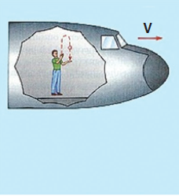
Newtonian mechanics
inertial frames of reference
Newton's laws of motion are the same in all inertial frames of reference
Now what the boy standing on the ground will see?
Throw a ball up in the air while riding in a aero-plane the bodies move just as they do on earth.
Both Galileo and Newton were deeply aware of this principle that the laws of mechanics are the same in all inertial reference frames.
This is the classical principle of relativity.

Slide 7
Newtonian Mechanics was highly successful in describing motion in the
world of our everyday experiences.
What is the need for re-examining the same in the context of
relativity?
Application of the classical principle of relativity to explain the propagation of electromagnetic wave results in certain inconsistences.
We will learn about some of these inconsistencies.
The Newtonian relativistic world view could not easily incorporate the laws of electromagnetism
The question is:
What replaced it?

Slide 8
It was replaced by a radically different way of understanding the world
In 1905 Albert Einstein proposed his
special theory of relativity
Einstein was not the first to introduce relativistic notions in physics.
Then what special had he does?
Generalized the classical notion of relativity (applicable only for mechanics) to all physical phenomena

Slide 9
CLASSICAL RELATIVITY
Let us begin by considering a physical event i.e., something that happens at a point in space and at an instant in time.
Where did it take place?
When did it take place?
we specify an event by four measurements in a particular frame of reference - three for the position, say (x, y, z) in Cartesian coordinates and one for the time t.
The four numbers (x, y, z, t) specify the event in that reference frame: the first three numbers specify its position and the forth is the time at which it occurred.
We must first establish a frame of reference to accurately describe where and when
an event happens.

Slide 10
we shall restrict our study to what are called inertial reference frames, the frame of reference in which Newton's first law holds true.
In an inertial frame of reference, objects at rest remain at rest and objects moving uniformly in a straight line continue to do so, unless acted upon by a external force.
Any frame that moves with constant velocity relative to an inertial frame is also an inertial frame.

Slide 11
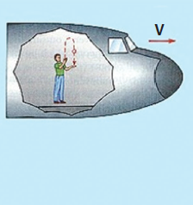
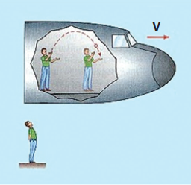
Suppose now that we have made space and time measurements describing an event in one inertial frame of reference. We want to describe the same event in another inertial frame of reference
Throw a ball up in the air while riding in an aero-plane moving uniformly with respect to the ground.
In the frame of reference attached to the aero-plane, the ball goes straight up and comes down along the same path.
Now what the boy standing on the ground will see?
We can use the Galilean coordinate transformations to describe an event in different inertial frames of reference.

Slide 12
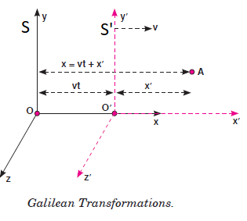
Galilean Coordinate Transformations
S is an inertial frame of reference with origin at O &
coordinate axes are (x, y, z)
S’ is another frame of reference with origin at O’ &
coordinate axes are (x’, y’, z’)
S’ moving with uniform velocity $\overset{⃑}{v}=v\hat{i}$ w.r.t S
S’ is also an inertial frame of reference
At t = t’ = 0, O & O’ coincides with each other
An event occurs at point A
Observer at S => (x, y, z, t)
Observer at S’ => (x’, y’, z’, t’)
Let’s find the relation between this two observations

Slide 13
Galilean Coordinate Transformations
Velocity of S’ w.r.t S is $\overset{⃑}{v}=v\hat{i}$ => S’ is moving along
x direction
x = x’ + vt
x’= x - vt
y’ = y
z’ = z
t’ = t
the generalized Galilean transformation in vector
Notation is
$$\overset{⃑}{r′}=\overset{⃑}{r}−\overset{⃑}{v}t$$
t‘ = t
$$[\overset{⃑}{r′}⇒position vector of A w.r.t S^{′}$$
$\overset{⃑}{r}⇒position vector of A w.r.t S$]
$$\frac{d\overset{⃑}{r′}}{dt}=\frac{d\overset{⃑}{r}}{dt}−\overset{⃑}{v}$$
$$\overset{⃑}{u′}=\overset{⃑}{u}−\overset{⃑}{v}$$
$$\overset{⃑}{u′}⇒velocity of A w.r.t S^{′}$$
$$\overset{⃑}{u}⇒velocity of A w.r.t S$$

Slide 14
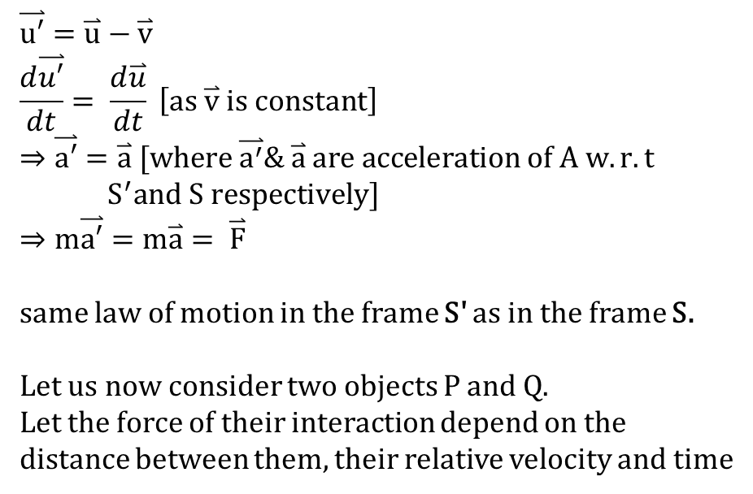
Galilean Coordinate Transformations
$$\overset{⃑}{u′}=\overset{⃑}{u}−\overset{⃑}{v}$$
$$\frac{d\overset{⃑}{u′}}{dt}= \frac{d\overset{⃑}{u}}{dt} \left[as \overset{⃑}{v} is constant\right]$$
$$⇒\overset{⃑}{a′}=\overset{⃑}{a} [where \overset{⃑}{a^{′}}\& \overset{⃑}{a} are acceleration of A w.r.t$$
$$S^{′}and S respectively]$$
$$⇒m\overset{⃑}{a′}=m\overset{⃑}{a}= \overset{⃑}{F}$$
same law of motion in the frame S' as in the frame S.
Let us now consider two objects P and Q.
Let the force of their interaction depend on the
distance between them, their relative velocity and time
$${x′}_{P}−{x^{′}}_{Q}=x_{P}−x_{Q} ;{y^{′}}_{P}−{y^{′}}_{Q}=y_{P}−y_{Q};{z^{′}}_{P}−{z^{′}}_{Q}=z_{P}−z_{Q}$$
${t′}_{P}−{t^{′}}_{Q}=t_{P}−t_{Q} [Galilean transformation do not change time]$
Forces remain inverient under Galiliean Transformations

Slide 15
Galilean Principle of Relativity
According to the Galilean transformations
Time interval, space interval (distance) and relative velocity measurements and hence the
Force law in mechanics is the same in all inertial frame.
The relative velocity of the frames can be arbitrary and does not affect these results.
The basic postulate of classical mechanics that the mass of a body is an invariant quantity.
The laws of mechanics can be written in the same form in all inertial frames.
If they hold in one inertial frame, they will also hold in all other inertial frames.
It is a limited principle of relativity in that it applies to only the laws of mechanics

Slide 16
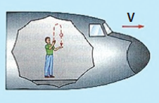
What the Galilean principle of relativity means?
Suppose you arc in a car
The car is moving at a constant speed and you cannot look out.
To you, all mechanical experiments performed and all mechanical phenomena
occurring in the car will appear the same as if the car were not moving.
No mechanical experiment performed in the
car could help you determine whether it was
moving uniformly or was at rest.
Of course, you did not look out

Slide 17
What the Galilean principle of relativity means?
If the laws of mechanics are true in one inertial frame of reference, they will be true
and of the same form in any other inertial frame as well.
As far as mechanics is concerned there is no preferred inertial frame of reference in
which alone the classical laws have the most basic form.
There is no absolute frame of reference.

Slide 18
An interesting aspect of the classical principle of relativity
Absolute Space and Absolute Time
According to Newtonian mechanics and Galilean relativity, the measurements of length (relative position), mass, time and their relationship ate independent of the relative motion of an inertial observer.
There exist absolute space intervals and absolute time intervals in Newtonian mechanics.
In other words we may say that space and time exist in themselves and have-properties that do not depend upon anything else.

Slide 19
"Absolute space, in its own nature, without relation to anything external, remains always similar and immovable."
Space represents a giant empty box which contains material objects and various physical phenomena take place in it, and it does not get affected by these.
Likewise time is thought to flow absolutely, uniformly and evenly without affected by any actual events that happen as time passes.
"Absolute true and mathematical time, of itself, and from its own nature, flows equally without relation to anything external, and is otherwise called duration"

Slide 20
Newton's world-view
Space and time are things external in relation to nature.
There is no relationship between space and time
the properties of space are determined independently of movements of objects with the passage of time
the flow of time is independent of the spatial properties of such objects.
In a nutshell, as per Newtonian ideas, space and time exist by themselves, independent of each other and do not depend on material bodies located in space or physical phenomena occurring therein.

Slide 21
Galilean principle of relativity applies to mechanical phenomena
Do other laws of physics (e.g., the laws of electrodynamics and optics) have the same form in all inertial frames?
are they invariant under a Galilean transformation?
When the principle of relativity was applied to Maxwell's equations, certain problems arose immediately - they did not seem to obey it.
Let us briefly outline some of these problems.

Slide 22
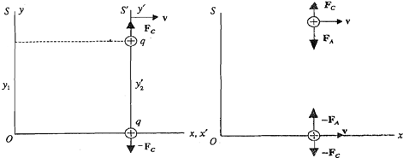
Problems of Relativity vis-a-vis Laws of Electromagnetisrn
Let us consider two equal, positive
point charges carrying charge +q.
first examine the system as seen by
an observer in S'.
one charge rests at the origin of S' and the other rests at a distance y₂’ on the y' axis.
The electromagnetic force that be charges at rest exert on each other in S’ is
$$F_{C}=\frac{1}{4πε_{0}}\frac{q^{2}}{{y′}_{2}^{2}}$$
What the observer at S will See

Slide 23
Problems of Relativity vis-a-vis Laws of Electromagnetisrn
The observer in S sees the charge q
unchanged and y₁ = y₂’.
Coulomb's force law is unchanged.
The observer in S also sees both charges
moving to the right at a speed v.
Now two positive charges moving to the right constitute two conventional parallel
currents => attract each other
The total force in S has two components - the electrostatic force of repulsion and the
attractive force between parallel currents.
We find that it is different from the force in S'.
According to Newtonian physics, these forces should be the same
This is an inconsistency

Slide 24
Another problem
When we try to transform Maxwell's equations according to the Galilean coordinate
transformations - they change their form.
the wave equation for electromagnetic fields deduced from Maxwell's equations does not
remain the same.
There seems to be a fundamentally disagreement between Maxwell's theory of
electromagnetic fields, Newtonian mechanics and Galilean principle of relativity.
Historically, this disagreement centered around the 'problem of light'
We too would like to focus on this problem.
However, shall confine ourselves only to one aspect of light, namely its propagation.

Slide 25
Another problem
We know that one of the consequences of Maxwell's equations is that light is an
electromagnetic wave, propagates in all directions at the same speed
Another consequence of The equations is that if the source of light is moving, the
light emitted still travels at the same speed c.
This brings up an interesting problem when Galilean relativity is applied to the
propagation of light.
c = 3 x 10⁸m/s.
Let us examine it

Slide 26
Galilean Relativity and the Speed of Light
The wave nature of light was recognized even before Maxwell described its
electromagnetic nature.
Wave required a medium to propagate.
So what was the medium for propagation of light?
Nineteenth century physicists believed that light propagated through a rarefied,
all-pervasive (space 'filling’) elastic medium called luminoferous ether, so fine that
planets and other heavenly bodies passed through it without appreciable friction.
Maxwell described the electromagnetic nature of light waves, the associated electric
and magnetic fields were visualized as stresses and strains in the ether.
It was in his medium that light propagated with a speed $c= \frac{1}{\sqrt{ε_{0}μ_{0}}}$
When the Galilean principle of relativity was applied to the propagation of light in
ether, it led to an inconsistency.

Slide 27
Let us try to understand the inconsistency
consider a frame S with respect to which light travels with velocity c.
What is the velocity of light in a frame S' moving with a constant velocity u with respect to S?
Let us carry out Galilean velocity transformations
$$\overset{⃑}{v′}=\overset{⃑}{c}−\overset{⃑}{u}$$
Where $\left|\overset{⃑}{v′}\right|= \sqrt{c^{2}+u^{2}−2 \overset{⃑}{c}.\overset{⃑}{u}}⇒speed of light in S′$

Slide 28
$$\left|\overset{⃑}{v′}\right|= \sqrt{c^{2}+u^{2}−2 \overset{⃑}{c}.\overset{⃑}{u}}$$
speed of light in S' becomes direction depended
If c is in the direction of u, the speed of light in S' is c - u.
In the direction opposite to u, the speed of light in S is c + u.
In any other direction it has a value between c - u and c + u as given by equation
The speed of light would be different in different inertial frames of reference
Maxwell's equation would have to be of different forms in different inertial frames of reference, to give different speeds of light in those frames
Galilean principle of relativity is incompatible with
the laws of electromagnetism

Slide 29
Let us accept both the Galilean transformation and the laws of electromagnetism (or Maxwell's equations) as basically correct.
Then it follows that there is one unique privileged inertial frame of reference (the absolute frame) in which Maxwell’s equations are valid. In this unique frame the speed of light would be $c= \frac{1}{\sqrt{ε_{0}μ_{0}}}$
In other frames it would be different.

Slide 30
The Galilean relativity principle does apply to Newton's laws of mechanics but
not to MaxwelI's laws of electromagnetism.
Correct consequences
Retain the Relativity
Principle for mechanics
but not for electrodynamics.
Newton's mechanics
remains unchanged. Laws of
electromagnetism hold only
in one privileged frame of
reference, the ether frame.
If this were correct we
should be able to locate the
ether frame experimentally
Retain the Relativity Principle
for both mechanics and
electrodynamics but hold
the laws of electromagnetism
as not correct.
If this were correct, we should
be able to do experiments that
show deviations from the
electromagnetic theory.
Need to reformulate the laws
of electromagnetism.

Slide 31
The Galilean relativity principle does apply to Newton's laws of mechanics but
not to MaxwelI's laws of electromagnetism.
Correct consequences
Retain the Relativity Principle for both mechanics and electrodynamics. But hold
that the Newtonian mechanics is not correct.
If this alternative were correct then we should be able to do experiments which
show deviations from Newtonian mechanics.
Need to reformulate Newton's Laws.
Have to give up the Galilean transformation because they do not give us an
invariant form of Maxwell's equations.
Need to look for some other transformation which is consistent with classical
electromagnetism and the new laws of mechanics.

Slide 32
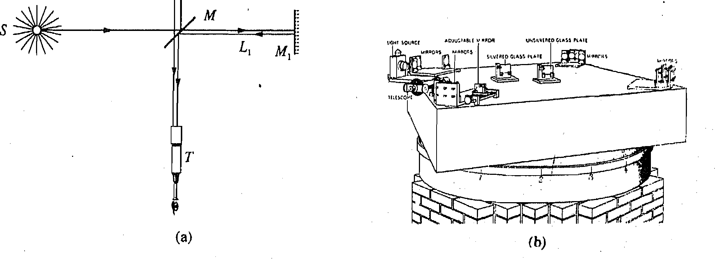
Attempts to Locate the Absolute Frame -The Michelson- Morley Experiment
(a) Schematic representation of Michelson - Morley experiment; (b) the apparatus

Slide 33
The Michelson- Morley Experiment
Let us first understand what was being investigated through this experiment.
When we say that sound travels at 340 m/s, i.e., the speed sound with respect to air.
If we move through still air towards an oncoming sound wave at a speed of 30 m/s (relative to the air), we observe the speed of sound to be 310 m/s.
The speed of sound relative to us varies with our speed relative to air.
The ether hypothesis suggests that the earth is moving in the ether medium as it
orbits the sun.
The speed of light relative to an observer on the earth varies with the earth's speed relative to the ether.
The speed at which the earth orbits the sun is 30 km/s, about 0.01% of the speed of light. This is the maximum change which we can observe in the speed of light on earth as it moves through ether.

Slide 34
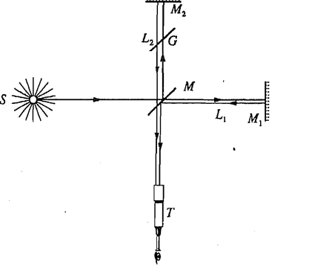
The Michelson- Morley Experiment
Michelson, in 1881, and then in collaboration with Morley, in 1887, performed an experiment designed to detect such a change in the speed of light.
The essential principle of the experiment was to send a light-signal from a source to a
mirror and back, noting the total time taken. The experiment was to be done twice:
in the direction of earth's motion in ether,
&
(ii) at right-angles to it

Slide 35
The Michelson- Morley Experiment
A beam of light from a source S (fixed with respect to the apparatus) is separated into two coherent beams by a partially silvered mirror M inclined at 45⁰ to thebeam direction.
Two mirrors M₁ and M₂ are placed at nearly equal distances from M and at right angles to each other. These reflect the beams back to M.
A part of each of the two beams reflected by M₁ and M₂ respectively, are reunited at M and the recombined beams are observed through a telescope T
A glass plate G is placed between M and M₂ to compensate for the extra distance travelled by light through M to M₁.
The two parts of the split beam will interfere with each other.

Slide 36
The Michelson- Morley Experiment
Let the time taken for light to travel from M to M₁ and back is t and that to travel from M to M₂ and back is t'.
For constructive Interference
t - t' = 2nT, n=1, 2, 3,...........................(1)
and for destructive interference
t – t’ = (2n+1)T, n = 1, 2, 3, ………………(2)
T is the time period of the light wave.
So the existence of a time difference between the two paths travelled by light influences the illumination of a given point (say A) viewed through the telescope.
It is either bright (constructive interference) or dark (destructive interference).
If M₁ and M₂ are very nearly at right angles, the fringe pattern consists of nearly parallel lines.

Slide 37
The Michelson- Morley Experiment
Now, suppose we rotated the entire apparatus
by 90⁰ in the plane of M, M₁ and M₂
the orientation of MM₁ and MM₂ relative to
the direction of Earth's motion through ether
would change.
This would alter the time taken along each
path and thus change the illumination of the
point A. Or we could say that the fringe pattern would shift.
The expected shift was of the order of four-
tenths of a fringe.
Michelson and Morley took utmost care in eliminating ail possible sources of error, such
as stresses and temperature effects. And this shift should have been clearly observable.
No fringe shift was observed.

Slide 38
The Michelson- Morley Experiment
One could say that at the time when the experiment was being done, the earth
was at rest relative to the ether, However, the result did not change when it was
repeated after a gap of six months.
The experiment was repeated many times by many workers over a 50-year period,
in more sophisticated ways, at different times of the year, but the result was
always the same.
As far as Michelson was concerned, its implication was clear as he wrote at that
time
'The result of the hypothesis of a stationary ether is shown to be incorrect.‘
But the Hypothesis was not given up immediately

Slide 39
Various experiments performed to measure the speed of light over the years have
confirmed this result. Indeed, the speed of light in free space has been found to be
constant at all times.
It is independent of the place where measurements were carried out,
It does not depend on its frequency
Does not depend on the nature and motion of its source.
Independent of direction of its propagation.
It is also constant with respect to all inertial frames of reference.
Thus, experiments help us to accept, indisputably, the following principle.
The speed of light in free space is a universal constant.

Slide 40
This result contradicts the Galilean principle of relativity.
At the same time the laws of electromagnetism are upheld by experiment.
Moreover in certain other experiments performed in the early twentieth century
departures from Newtonian mechanics were observed.
In 1902, the motion of electrons (emitted by radioactive sources) in electric and
magnetic fields was investigated experimentally. It was found that Newton's second law
did not correctly describe the motion of these electrons which moved with velocities
close to that of light.
To sum up, we have found that the classical principle of relativity is incompatible with
the laws of electromagnetism.
Michelson-Morley experiment fails to detect ether (i.e., an absolute frame of reference).
Thus, the ether hypothesis is untenable. It is experimentally established that the speed
of light, in free space, is a constant.

Slide 41
Hence we can see that a relativity principle applicable to both mechanics and to
electromagnetism, is operating.
Clearly it is not ,the Galilean principle, since that requires the speed of light to
depend on the frame of reference in which it is measured.
We conclude that the Galilean transformations should be replaced.
Hence, the laws of mechanics, which are consistent with these transformations,
need to be modified.
Einstein's special theory of relativity emerged

Slide 42
Numerical problems on STR
A separate problem set is available along with this video lecture.

Slide 43
Thank You

